Slide 1
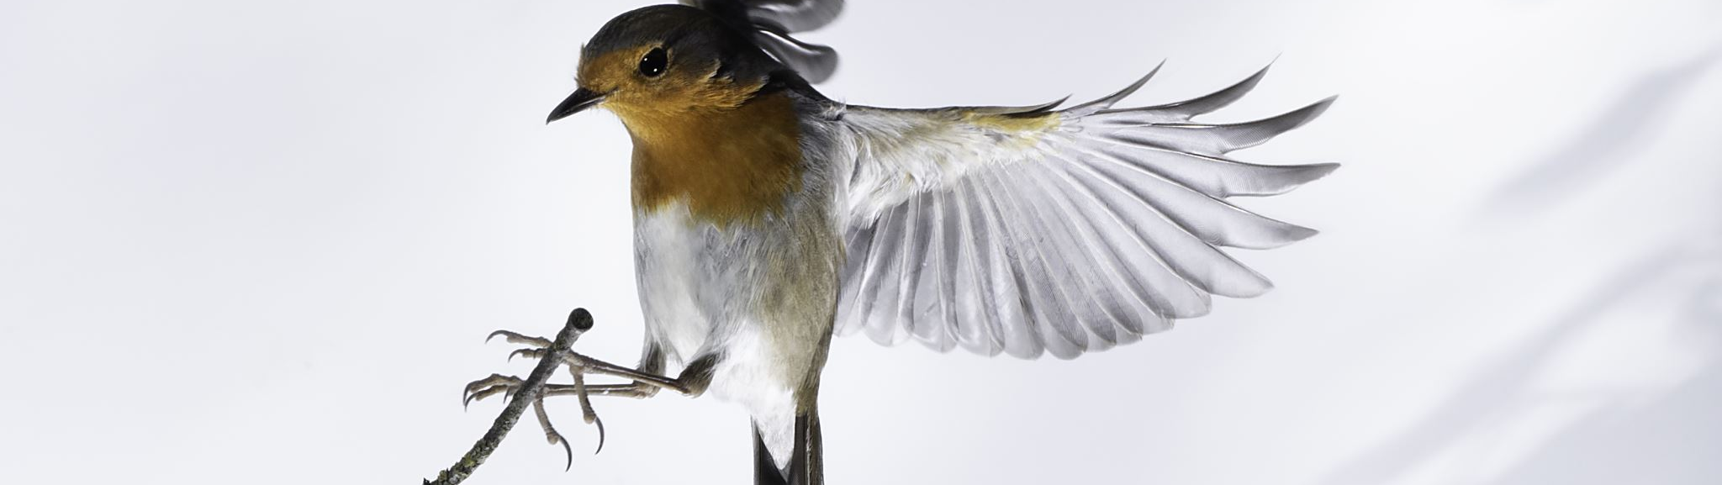
Classifying Bird Species With Image Recognition
Brendon Bottle
And
Sean McManus

Slide 2
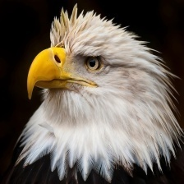
Problem Description
Project goal: Classify images of birds into the correct species
Potential use case: Bird population counts
Method: A convolutional neural network optimized for image classification
Notes:
We wanted to try our hand at an image classification task.
After looking at a few possibilities we settled on classifying bird species as it would involve higher resolution images, with color and varying angles and poses.
One interesting use case of a classifier like this would be to estimate different populations using photos captured by bird enthusiasts.
We chose to use a CNN as it is well suited for this type of task.

Slide 3
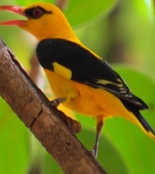
Dataset
The full dataset contains 525 unique species of birds with 100-200 images per species
The training data was reduced to 20 species with 100 images per species
The validation and test sets contain 5 image for each type of bird
Each image contains only one bird, which comprises at least 50% of the pixels
Notes:
The dataset we used had 100-200 images per species of 525 unique species.
To make the scope of the problem more manageable for this project, we reduced our total number of species to 20.
For each of the 20 species we decided to balance the data and use 100 images for each.
The birds in each image would comprise at least 50% of the pixels, and have a resolution of 224x224
One challenge we had was that these images contained mostly males but a few females for each species. birds can have drastic changes in plumage based upon sex.

Slide 4
Base Model Performance
Model Used | EfficeintNetB0
Weights Applied | ImageNet
Epochs Run | 5
Best Validation Accuracy | 100%
Best Validation Loss | 0.0015
Notes:
To give us something to aim for the authors of the dataset suggested a pre-trained EfficentNetB0 model with ImageNet weights.
This proved to be very powerful, after only 5 epochs the model was already predicting with 100% accuracy on the validation data with close to no loss.
This was promising because it indicated this problem could be solved very well by a well designed neural network.

Slide 5
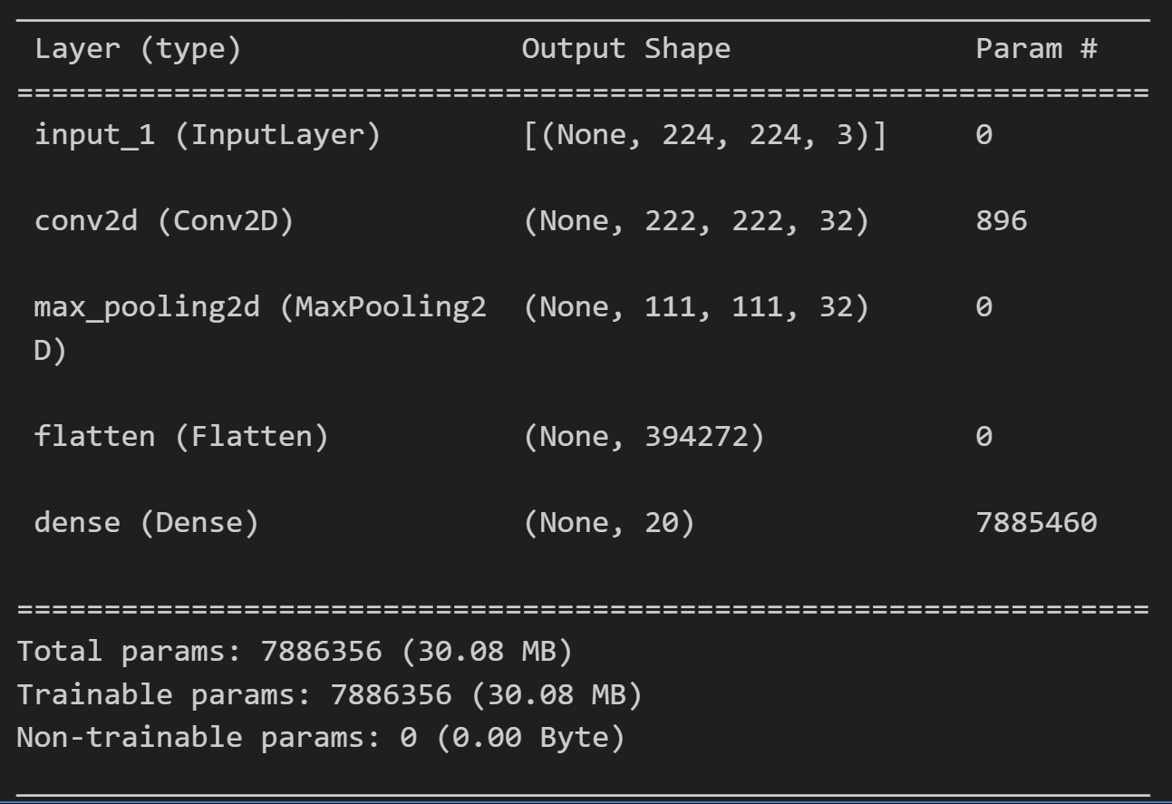
Simple Model Performance
Epochs Run | 21
Validation Accuracy | 81%
Validation Loss | 0.8571
Notes:
We defined our initial starting point as a simple model with a single convolutional layer, a MaxPooling layer, and a dense layer with a softmax classifier.
We implemented early stopping and after 21 epochs we achieved a validation accuracy of 81%

Slide 6
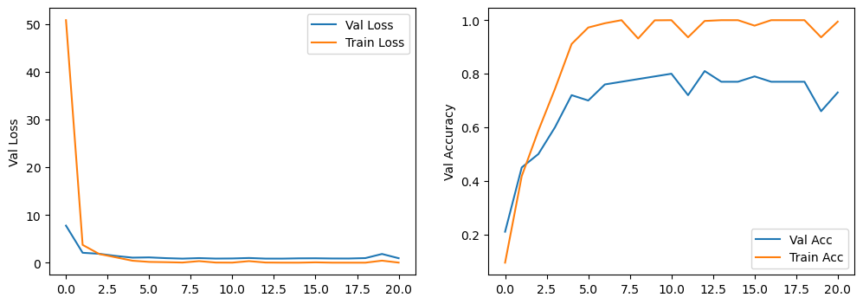
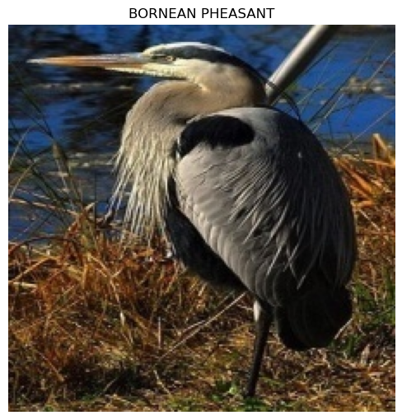
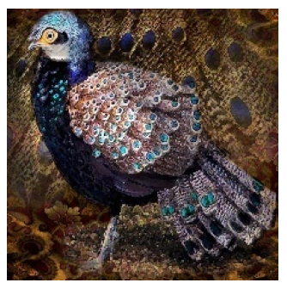
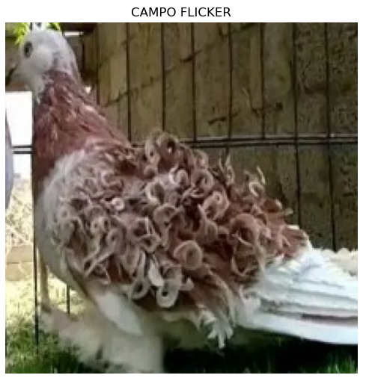
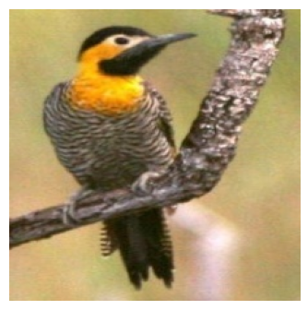
Simple Model Evaluation
Notes:
While manipulating various parameters in our simple model we found that it would very quickly approach perfect training accuracy, but our validation accuracy would plateau and often decrease with more epochs.
To start gaining some insight we looked at what species our model was predicting poorly.
A few of the birds it struggled with were the frill back pigeon,
and blue heron. Looking at some of the images we found that the color, and pose of the frill back pigeon varied quite a bit and the main distinguishing feature is its strange fury back.
The blue heron could be seen with a long extended neck or curled up, flying and depending on the light can appear as several colors.

Slide 7
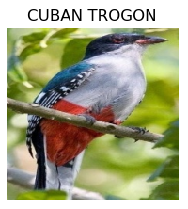
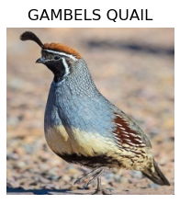
Simple Model Evaluation – Correct Birds
Good Classification
Large, colorful patches
Unique characteristics (Quail’s Crest)
Bad Classification
Muted/blended Colors
Color Variance
Notes:
We then looked at where our model was classifying with very high accuracy and we found that birds with very sharp color lines, like the cuban trogans belly and a common (among the same species) shaped feature, such as the quails crest on its head allowed our model to easily identify them.

Slide 8
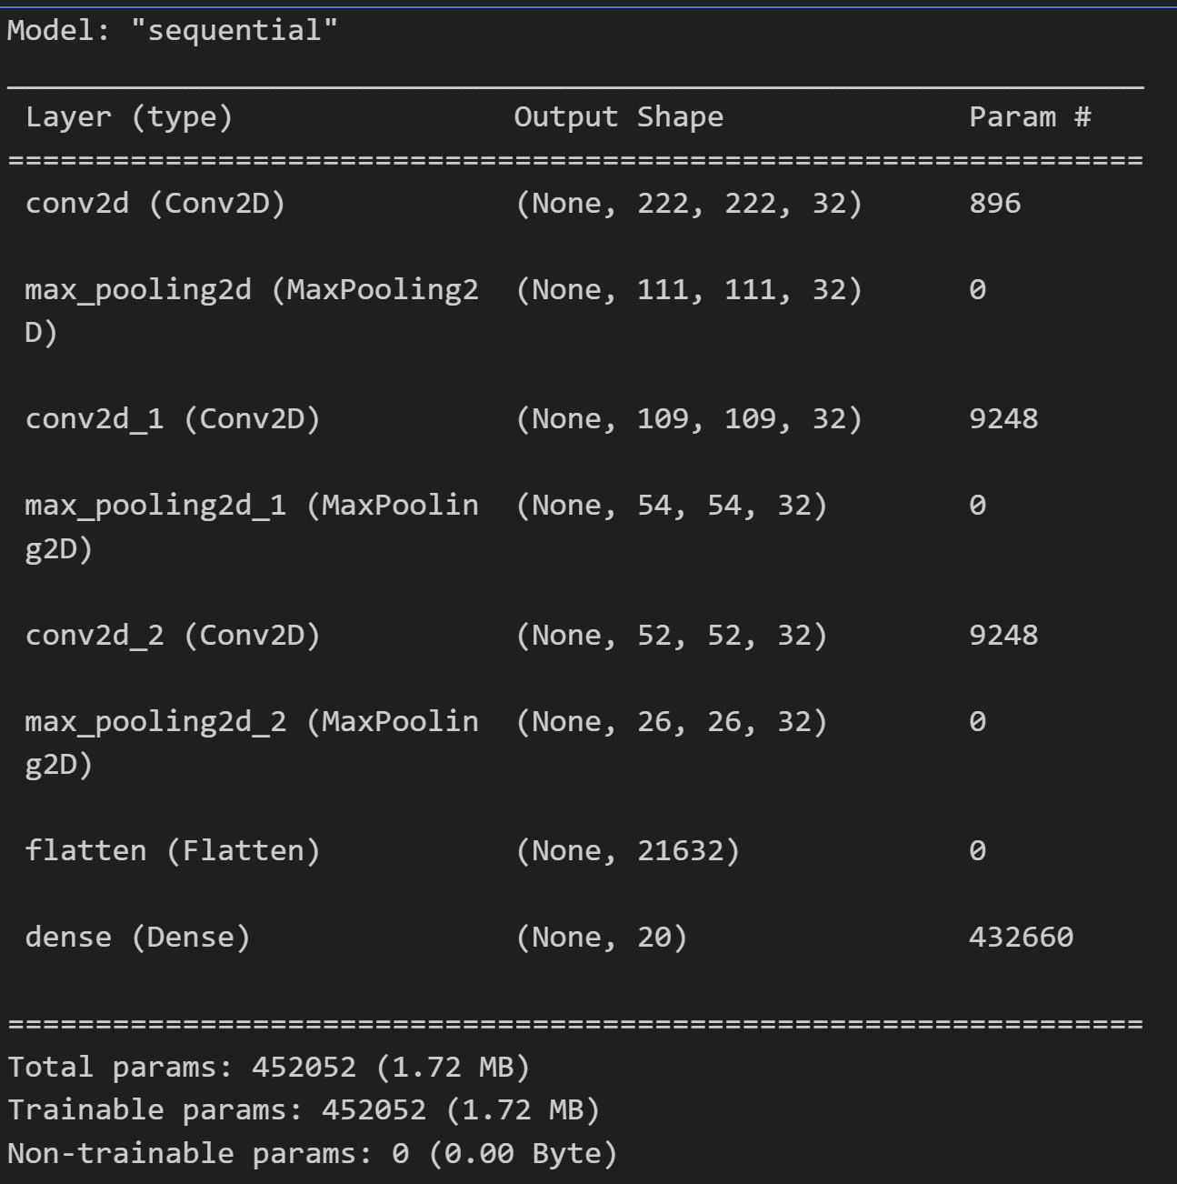
Proposed Improvements
Increase Model Complexity
Add more CNN layers to differentiate features more
Included MaxPooling to support model invariance
Notes:
Based on our evaluation, it was apparent that the model was only learning very shallow features and making its predictions on those, leading to limited predictive power and overfitting. This worked very well for our birds that were distinctive but meant that the model wasn’t learning anything about the less distinctive birds, or the ones with more variation.
As a first step to helping our model, we increased the complexity to get the model to recognize more of the less distinctive features. We added two CNN layers to help differentiate the features more and followed each of them with MaxPooling to strengthen model invariance.

Slide 9
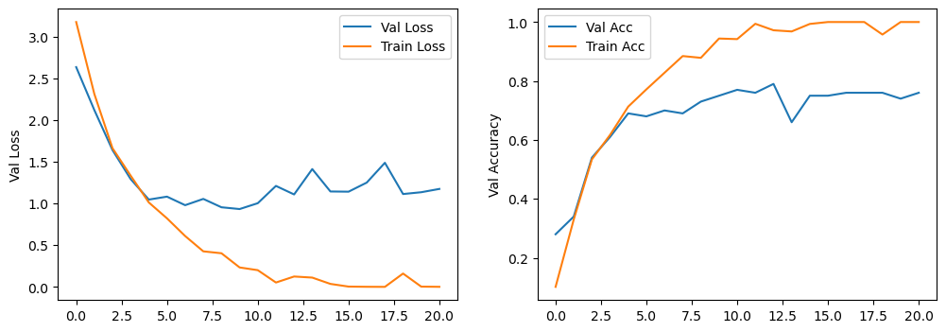
Complex Model Evaluation
Improvements
More species 100% correctly classified
Some classes improved their predictions
Challenges
Significant decrease in some species
Model overfitting
Validating Assumptions
Distinctive features still taking precedent
Grayscale model resulted in significant drop in accuracy
Notes:
The additional complexity had a few impacts, some improvements and some challenges. The additional complexity did result in more species being classified 100% correctly, and some that had performed poorly improved. However, we also saw several birds did worse, some much worse than in the simple model. We were also still seeing overfitting, which wasn’t unexpected given that we’d made the model more complex.
Again, the birds that were doing well tended to be colorful or distinctive in some other way. Based on these birds, our assumption was that color was one of the most impactful features that our model was learning. To test this, we ran the complex model again, but this time trained it on grayscale images. In this case our accuracy plummeted and many of the birds that had been correctly classified were being misclassified. However, quails were still doing very well. This helped validate our assumption that the model was overlearning this distinctive features and making it less flexible for the other birds.

Slide 10
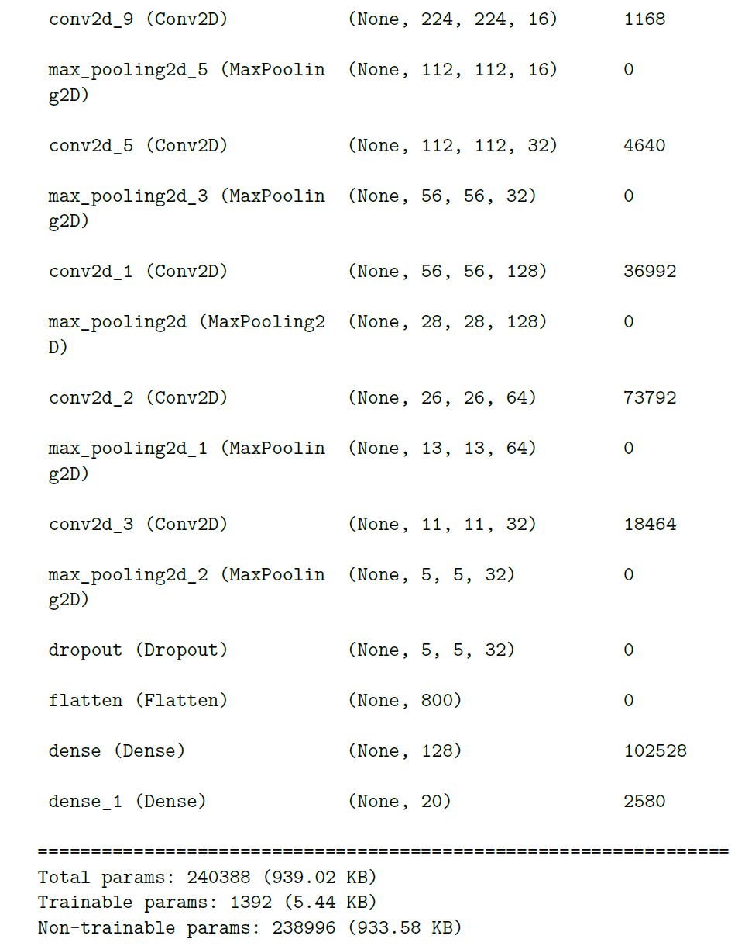
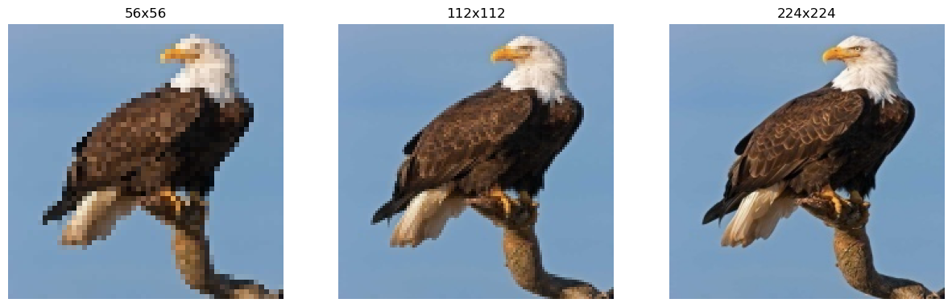
Progressive Resizing
Models trained on progressively higher quality images
Layered together to build a complex model
Weights of smaller scale models are locked to avoid learning noise from higher quality images
Filters, Dropout, and Epochs adjusted
Notes:
To help our model generalize more, we needed to address overfitting. Making our model simpler didn’t seem like an option since it was already pretty shallow, and color was clearly very important even it was causing the overfitting. So instead, we reduced the complexity of the images themselves.
To do this, we used a method called progressive resizing. This method works by downscaling the image to “fuzz” the details and eliminate noise. The model is then progressively built on images of higher quality with the weights of the previous layer being locked. This helps to ensure that the model doesn’t pick up too much noise from the higher quality pictures.
For our model we used our complex model on 56x56 images. We also increased the nodes in the three CNN layers to 128, 64, and 32 respectively in order to draw more information from these lower quality pictures. We then introduced a dropout layer to help combat the overfitting from our previous model.
We then trained two more CNN layers on 112x112 and 224x224 (the original size), decreasing the filters as the quality of the image increased to focusthe model on the smaller details.
Because we introduced the dropout layer, we also removed early stopping and let each model run for 100 epochs.

Slide 11
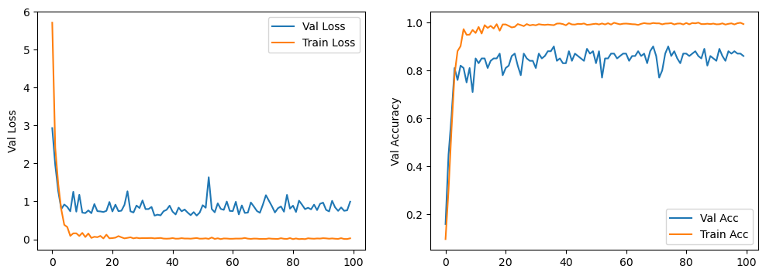
Progressive Model Evaluation
 | 56x56 | 112x112 | 224x224
Accuracy | 88.99% | 89.99% | 87.99%
Loss | 0.8063 | 0.6321 | 0.5862
Overfitting improved on this version
56x56 model gave a significant boost in accuracy
112x112 improved accuracy
224x224 dropped accuracy but loss improved
Notes:
This model saw an immediate, and significant, boost in accuracy when dropping images to 56x56. This validated our assumption that the model was learning less generalizable features from the details. When going to 112x112 we saw both an improvement in accuracy and loss, but the individual classes showed significant fluctuation in their predictions. The 224x224 model had similar results to the 56x56 model, although adding the additional data added confidence to those predictions.

Slide 12
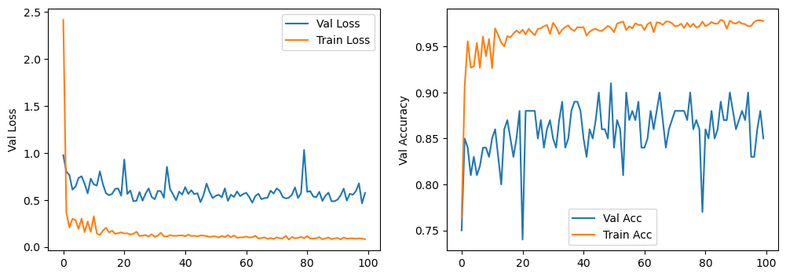
Additional Images
224x224 image quality not learning correct features for poorly classified birds
Added additional images to diversify poorly classified species
Validation Accuracy | 91%
Validation Loss | 0.3924
Notes:
All three models performed poorly on D-Arnauds Barbet and Cedar Waxwing, so we wanted to add more images to see if we would improve those classes specifically. Because the 112x112 was giving us the best accuracy and the 224 was giving us the best loss, I decided to rebuild the 224 model but reset the weights for the 224 layer and unlock the weights for the 112 layer, my hope was that adding the additional information would then help the 112 layer better identify those birds while still getting the gains in certainty that training the 224 model did.
This worked as we ended up with our best accuracy of 91% and our best loss of 0.5178

Slide 13
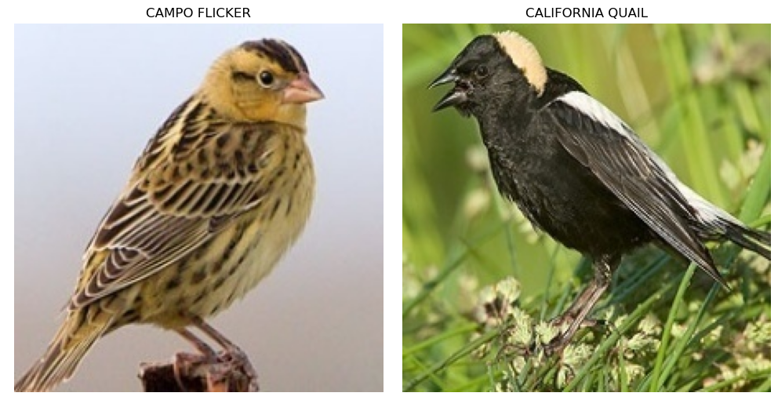
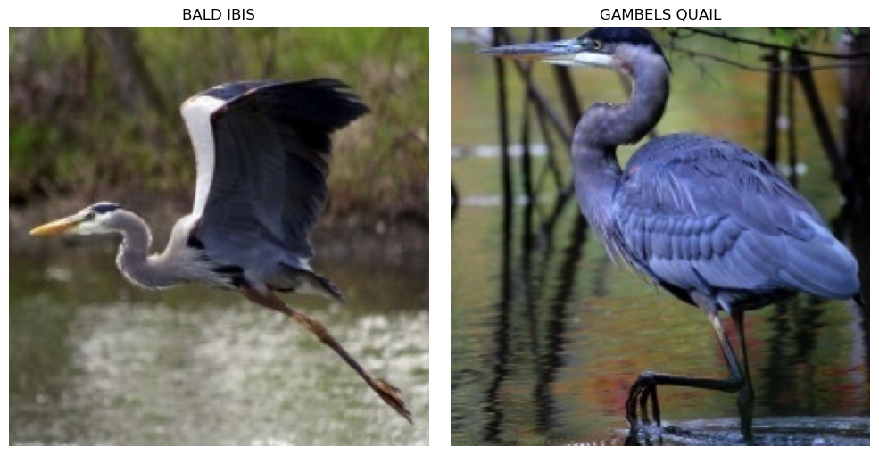
Final Test
Accuracy | 82.99%
Loss | 0.5899
Accuracy declined but loss was reasonably low
Structure of the validation set likely contributed to this
Next Steps include creating more robust validation set, increasing complexity, and introducing more image augmentation
Notes:
The model unfortunately did not perform as well on the test set as we would hope from the results of our testing. While our loss was on the lower side, the accuracy dropped down almost as low as our original simple model.
In reviewing the images from the validation and test sets, we determined that a challenge with our dataset was the validation data. Issues included ratio of males to females in the two sets (Bobolink had primarily images of the bird on the right in the validation set, but mostly the ones on the left in the test set) and imbalance of bird positions (blue heron poses in test and validation sets were very different).
Based on this evaluation, to get this perform better there are a few steps we could take:
Create a more robust validation set
Increase the complexity of our model further
Perform more image augmentation such as rotation, flips, and contrast shifts.

